Slide 1

Multiple Linear Regression
Presented by:
Elizer Ponio Jr.
Department of Computer Science
College of Computing and Information Technologies

Slide 2
Outline
What is Multiple Linear Regression?
Application Multiple Linear Regression
Objectives
Steps
Correlation

Slide 3
Multiple Linear Regression
Multiple Linear Regression is an extension of simple linear regression.
It determines the relationship between a dependent variable and two or more independent variables.
The independent variables can be either continuous or categorical.

Slide 4
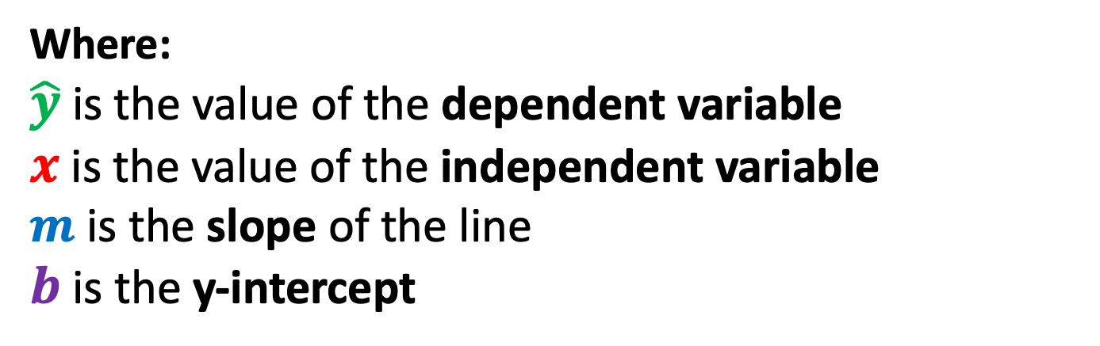
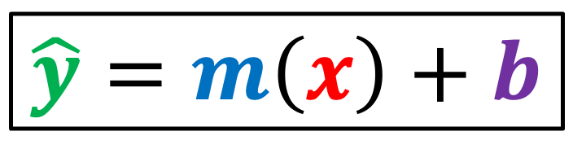
Recap: Simple Linear Regression
$$\hat{y}=m\left(x\right)+b$$
Where:
$\hat{y}$ is the value of the dependent variable
$x$ is the value of the independent variable
$m$ is the slope of the line
$b$ is the y-intercept

Slide 5
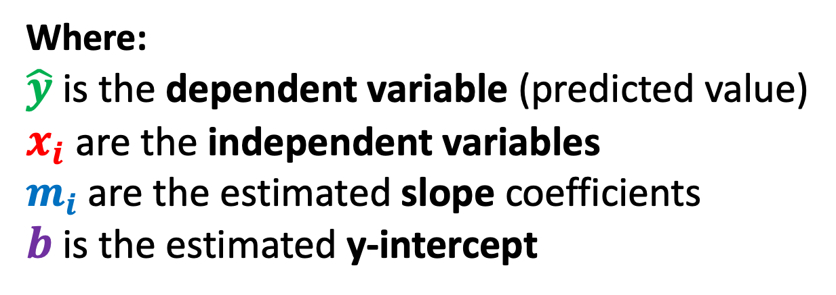
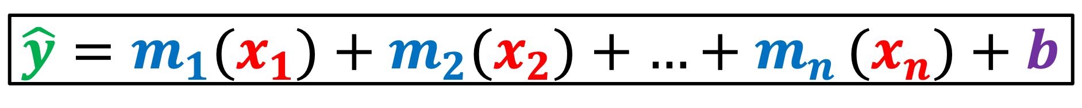
Multiple Linear Regression Equation
$$\hat{y}=m_{1}(x_{1})+m_{2}(x_{2})+{…+m}_{n}(x_{n})+b$$
Where:
$\hat{y}$is the dependent variable (predicted value)
$x_{i}$ are the independent variables
$m_{i}$ are the estimated slope coefficients
$b$ is the estimated y-intercept

Slide 6




Example: House Price Prediction
Independent Variables
Dependent Variables
Number of Bedrooms
House Price
Airconditioned?
In a mainroad?

Slide 7



Example: Company Profit Prediction
Independent Variables
Dependent Variables
Research and Development Spending
Company Profit
Administration
Marketing Spending

Slide 8
Objectives
Find out the independent variables which will be useful for prediction.
Important Note: Adding more independent variables to a multiple linear regression procedure does not mean the regression will be better or offer better predictions. In fact, it can make things worse!.

Slide 9
Objectives
The goal is for each independent variables to be correlated with the dependent variable, but not with one other.
Important Note: The addition of more independent variables create more relationships among them. So not only are the independent variables potentially related to the dependent variables, they are also potentially related to each other. When this happens, it is called multicollinearity.

Slide 10
Steps in Multiple Linear Regression
STEP | TASK
1 | Generate a list of potential variables, independent and dependent
2 | Collect data on the variables
3 | Check the relationships between each independent variable and the dependent variable using scatterplots and correlations.
4 | Check the relationships among the independent variables using scatterplots and correlations to remove redundant independent variables.
5 | (Optional) Conduct simple linear regressions for each independent variable and dependent variable pair.
6 | Use the non-redundant independent variables in the analysis to find the best fitting model.
7 | Use the best fitting model to make predictions about the dependent variable.

Slide 11

What is Multiple Linear Regression?
Application Multiple Linear Regression
Objectives
Steps
Correlation

Slide 12
Correlation
Correlation measures the strength of the relationship between two variables.
In other words, it tells you how closely two variables are related.

Slide 13
Types of Correlation
Positive correlation. A relationship between two variables in which one variables increases while the other increases, or one decreases while the other decreases.
Negative correlation. A relationship between two variables in which one variable increases as the other decreases, or one variable decreases as the other increases.
No correlation. There is no relationship between two variables.

Slide 14
Correlation
Correlation is measured on a scale from -1 to +1.
A value of -1 means that the variables are perfectly negatively correlated.
A value of +1 means that the variables are perfectly positively correlated.
A value of 0 means that the variables are not correlated at all.

Slide 15
Correlation Example: Sneaker Data
Number of Orders (Demand) | Available in Stock (Supply) | Price of Sneakers
1 | 5 | 2
2 | 4 | 4
3 | 3 | 5
4 | 2 | 4
5 | 1 | 5

Slide 16
Positive Correlation
Number of Orders (Demand) | Price of Sneakers
1 | 2
2 | 4
3 | 5
4 | 4
5 | 5
Price of Sneakers
Number of Orders (Demand)

Slide 17
Negative Correlation
Available in Stock (Supply) | Price of Sneakers
5 | 2
4 | 4
3 | 5
2 | 4
1 | 5
Price of Sneakers
Available in Stock (Supply)

Slide 18
Correlation Matrix
 | Number of Orders (Demand) | Available in Stock (Supply) | Price of Sneakers
Number of Orders (Demand) | 1 | -1 | 0.77
Available in Stock (Supply) | -1 | 1 | -0.77
Price of Sneakers | 0.77 | -0.77 | 1

Slide 19
No Correlation
Customer Age | Price of Sneakers
3 | 2
3 | 3
2 | 5
5 | 4
1 | 5
5 | 1.5
3 | 1
1 | 3
2 | 3
4 | 3
3 | 4
Price of Sneakers
Customer Age

Slide 20
References
https://www.investopedia.com/terms/m/mlr.asp
https://www.investopedia.com/terms/n/negative-correlation.asp
https://www.investopedia.com/terms/p/positive-correlation.asp

